Slide 1


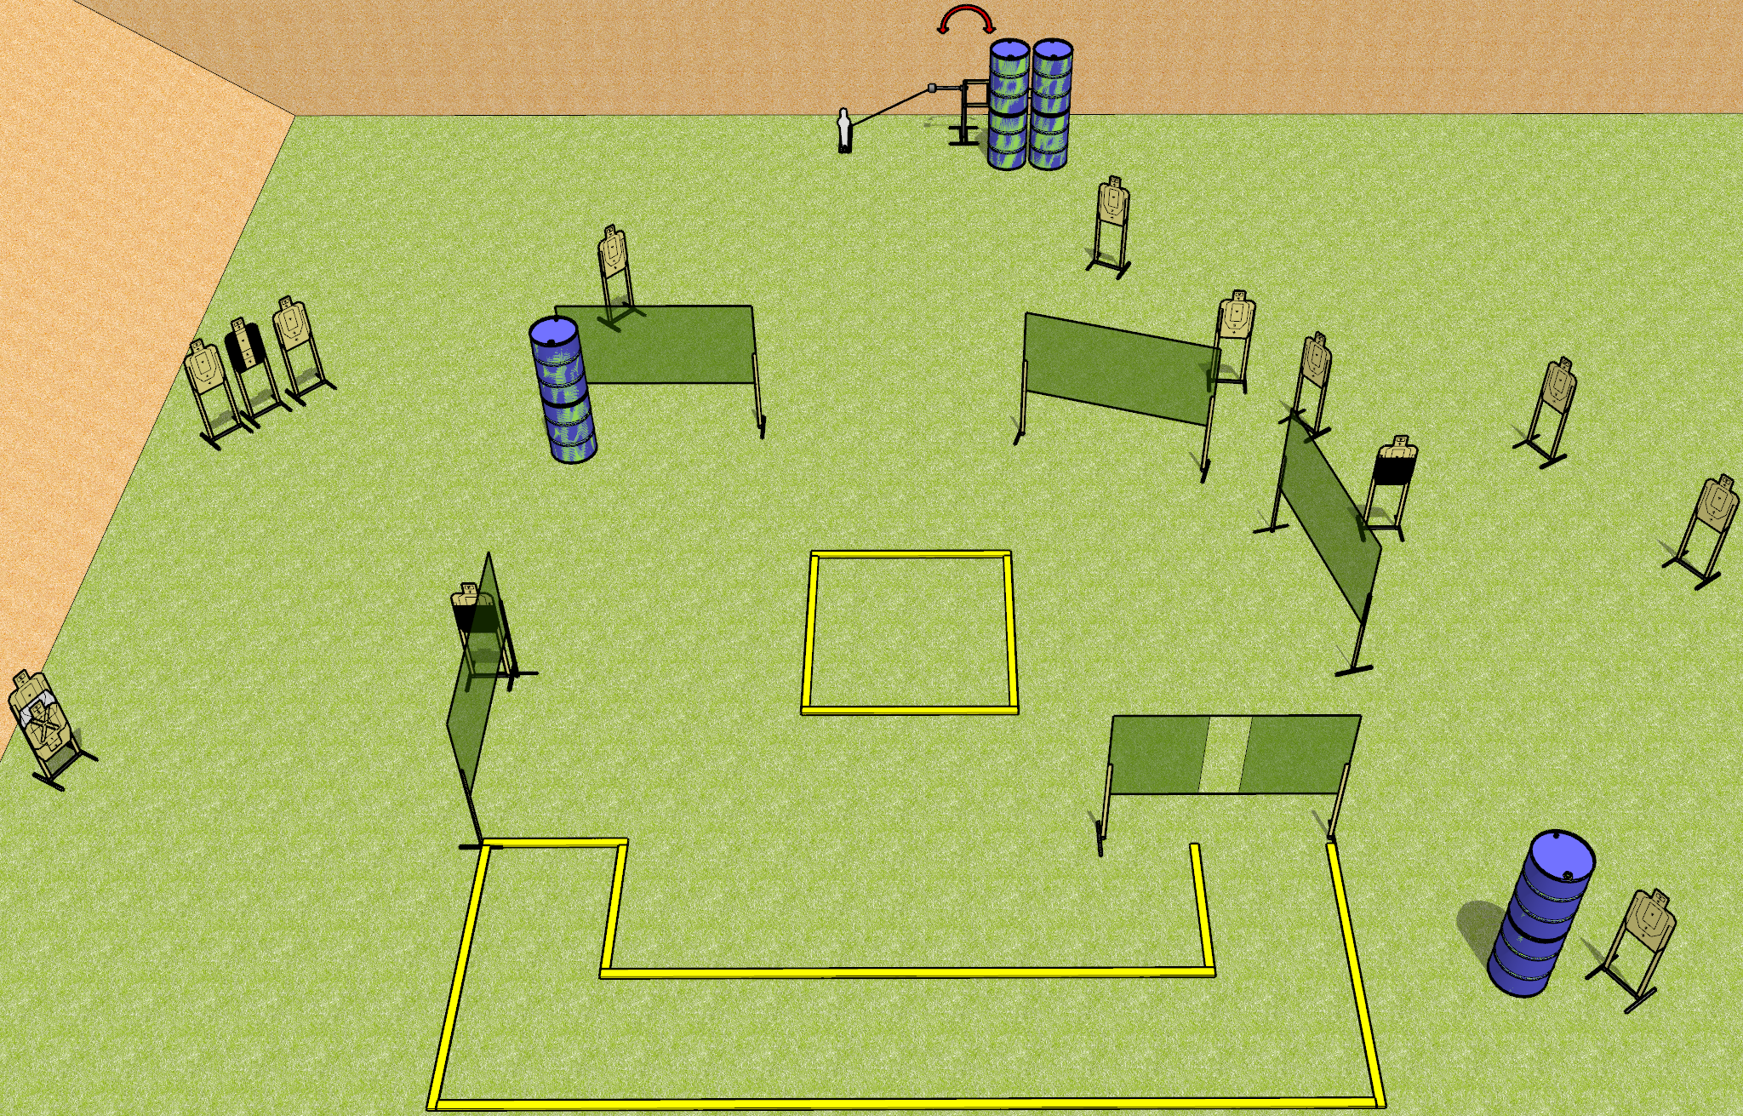
 | Dothan Gun Club – USPSA Match Smile! Course Designer : Drew Coleman
Round Count 31 rounds 15 USPSA 1 mini popper
Equipment List 3 medium fault lines 10 wall feet 2 50%, 1 tux 1 Swinger + activator
A
6’
B

Slide 2
Smile!
Written Stage Briefing
Smile! is a 31 round, 155 point, Comstock course of fire. There are 15 USPSA targets and 1 mini popper. The best 2 hits on paper will score, and steel must fall to score. The start signal is audible.
The swinger is activated by the mini popper, and remains visible at rest.
Handgun start position is inside shooting area A, wrists below belt. Handgun is loaded and holstered.
PCC start position is inside shooting area A, stock on belt. Loaded carbine is held with both hands, safety on.
On start signal, engage targets as they become available from within the shooting areas.

